Slide 1
Basic equations for α and n vectors in magneto- dynamics (MD)
approximation
Z
M
n
Y
G = K₁/3η
H_{k} = 2K₁/M_{s}
η - liquid viscosity
X
H₀(t)
K₁ – anisotropy constant
M_{s} – saturation magnetization

Slide 2
Numerical simulation results
II
I
III
1
2
3
1) – 3) Various modes of unit magnetization vector dynamics in
rotating magnetic field. Insert shows areas of these modes in (H, f) plane

Slide 3
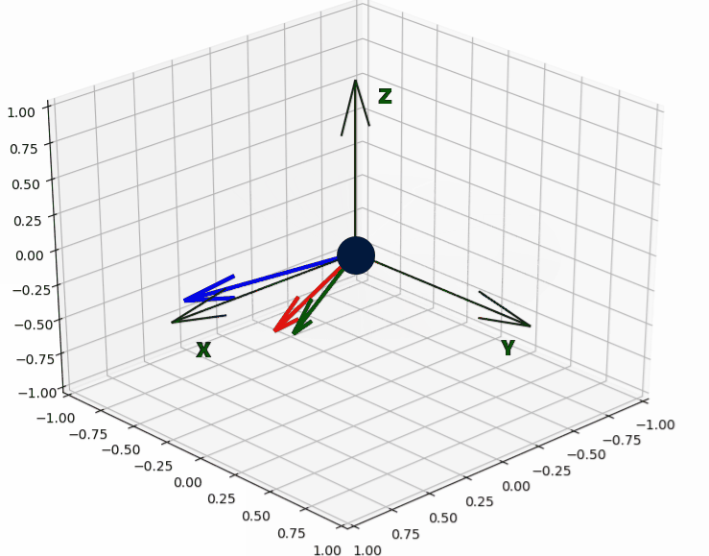
Mode 1: Unison rotation in magnetic field plane
I
Unit magnetization vector, α
Nanoparticle director, n
External magnetic field, H

Slide 4
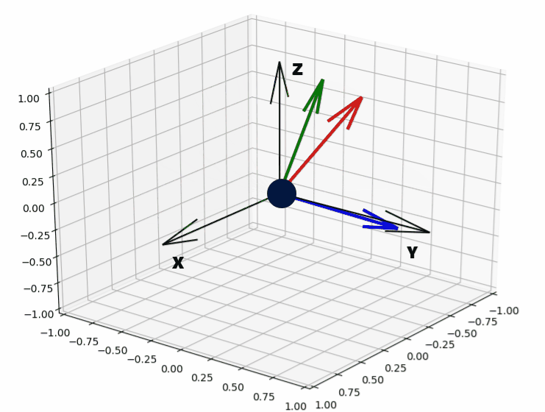
Mode 2: Unison rotation out of magnetic field plane
II
Unit magnetization vector, α
Nanoparticle director, n
External magnetic field, H

Slide 5
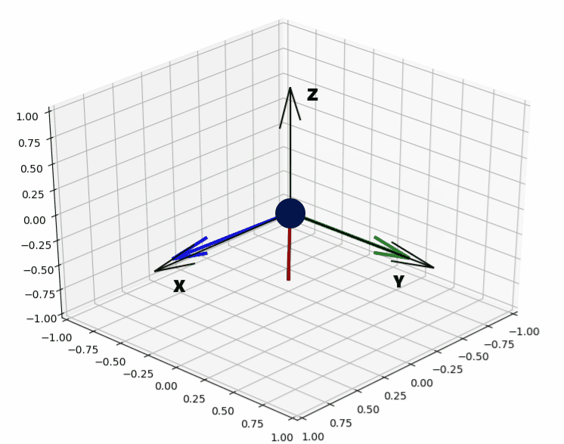
Mode 3: Periodic jumps of unit magnetization vector
III
Unit magnetization vector, α
Nanoparticle director, n
External magnetic field, H

